Slide 1
Community Engagement in the Budget Process
VASS-VASBO Workshop
December 15, 2016
Leslie Peterson, Assistant Superintendent, Arlington Public Schools

Slide 2
Overview
Background
Great Recession
School Board Direction
Online Budget Balancing Tool
Community Engagement Budget Calendar
Community Budget Meetings
“Citizen’s Guide to Understanding the Budget”
Executive Summary Budget/Press Packet
“At a Glance” Brochure
2

Slide 3
Background
Community Criticisms
Not involved
Didn’t get adequate information
Budget not transparent
Lengthy Public Hearings
No Real Direction from School Board
Great Recession Struck
Notes:
Here is a display of our 8 step CIP Process Loop.
Some exciting news, is that the loop been updated this year to include the MoreSeats Community Engagement timeline.

Slide 4
Great Recession
Superintendent’s First Budget
$44 Million Budget Gap
Wanted Community Input and Buy-In
Needed School Board Direction
Notes:
Here is a display of our 8 step CIP Process Loop.
Some exciting news, is that the loop been updated this year to include the MoreSeats Community Engagement timeline.

Slide 5
School Board Direction
Needed a Framework and Direction
Developed Budget Standards and Guiding Principles
Budget framework
Grounded in Strategic Plan
Guides budget development
Foundation for budget discussions with County
Created Budget Direction
Provided specific instruction around budget
Established School Board Priorities
To focus their work during the year
Notes:
Here is a display of our 8 step CIP Process Loop.
Some exciting news, is that the loop been updated this year to include the MoreSeats Community Engagement timeline.

Slide 6
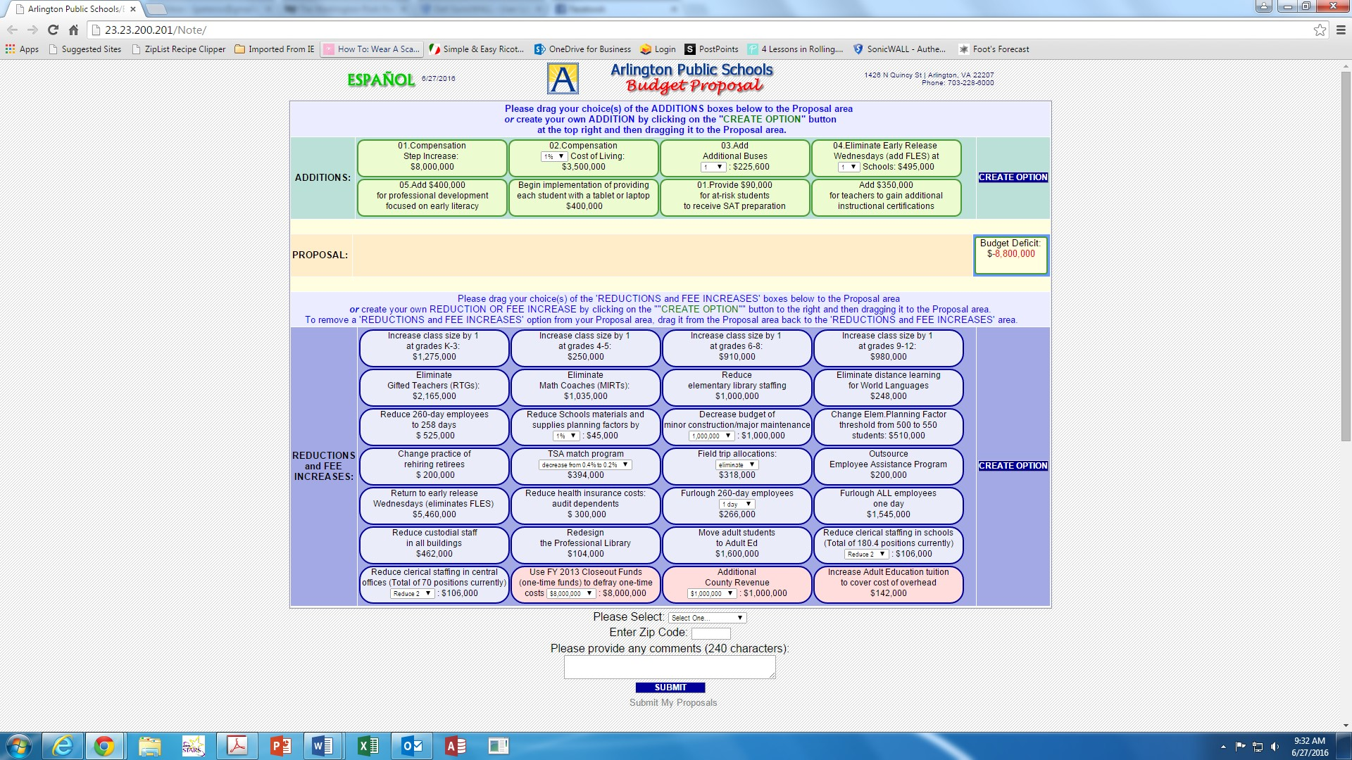
Online Budget Balancing Tool

Slide 7
Online Budget Balancing Tool
Great Recession
Resulted in $44 million budget gap
Difficult Decisions
Needed Community Buy-in
Developed Tool
Community could choose how to balance budget
Resulted In:
Community awareness of budget gap
Difficulty of deciding between options
Buy-in for eventual decisions made
4

Slide 8
Community Engagement Calendar

Slide 9
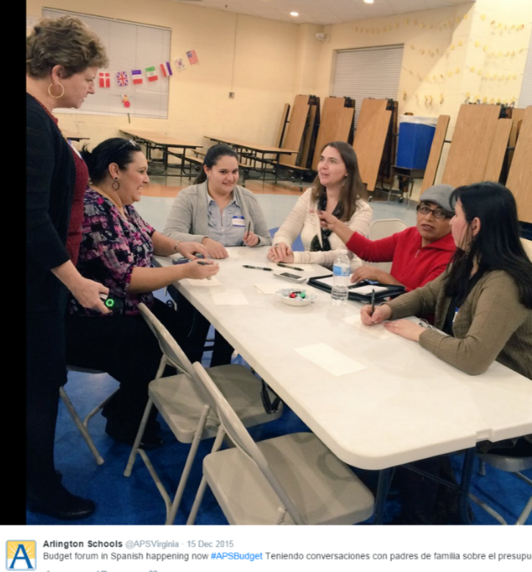
Community Engagement Calendar
All Community Engagement Opportunities
Easy to Use
Color Coded
Widely Distributed
4

Slide 10
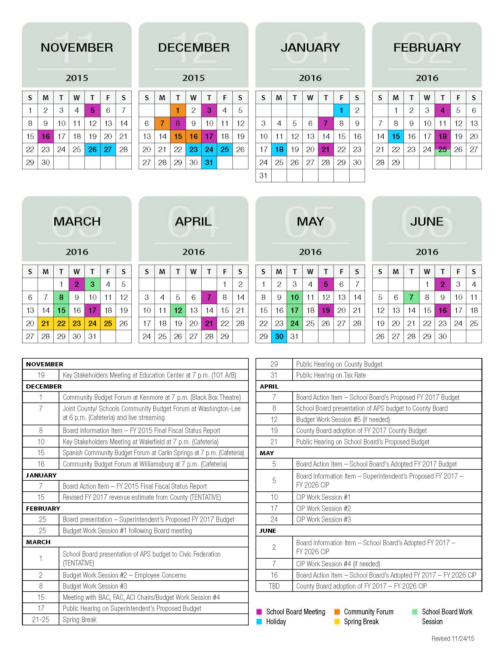
Community Meetings
10

Slide 11
Community Meetings
Joint Budget Forum with County
Community Budget Forums
Spanish Community Budget Forum
Key Stakeholders Meetings
Includes representatives from community and advisory groups
Sounding Board Meetings
Public Hearings
School Board Meetings
Budget Work Sessions
4

Slide 12
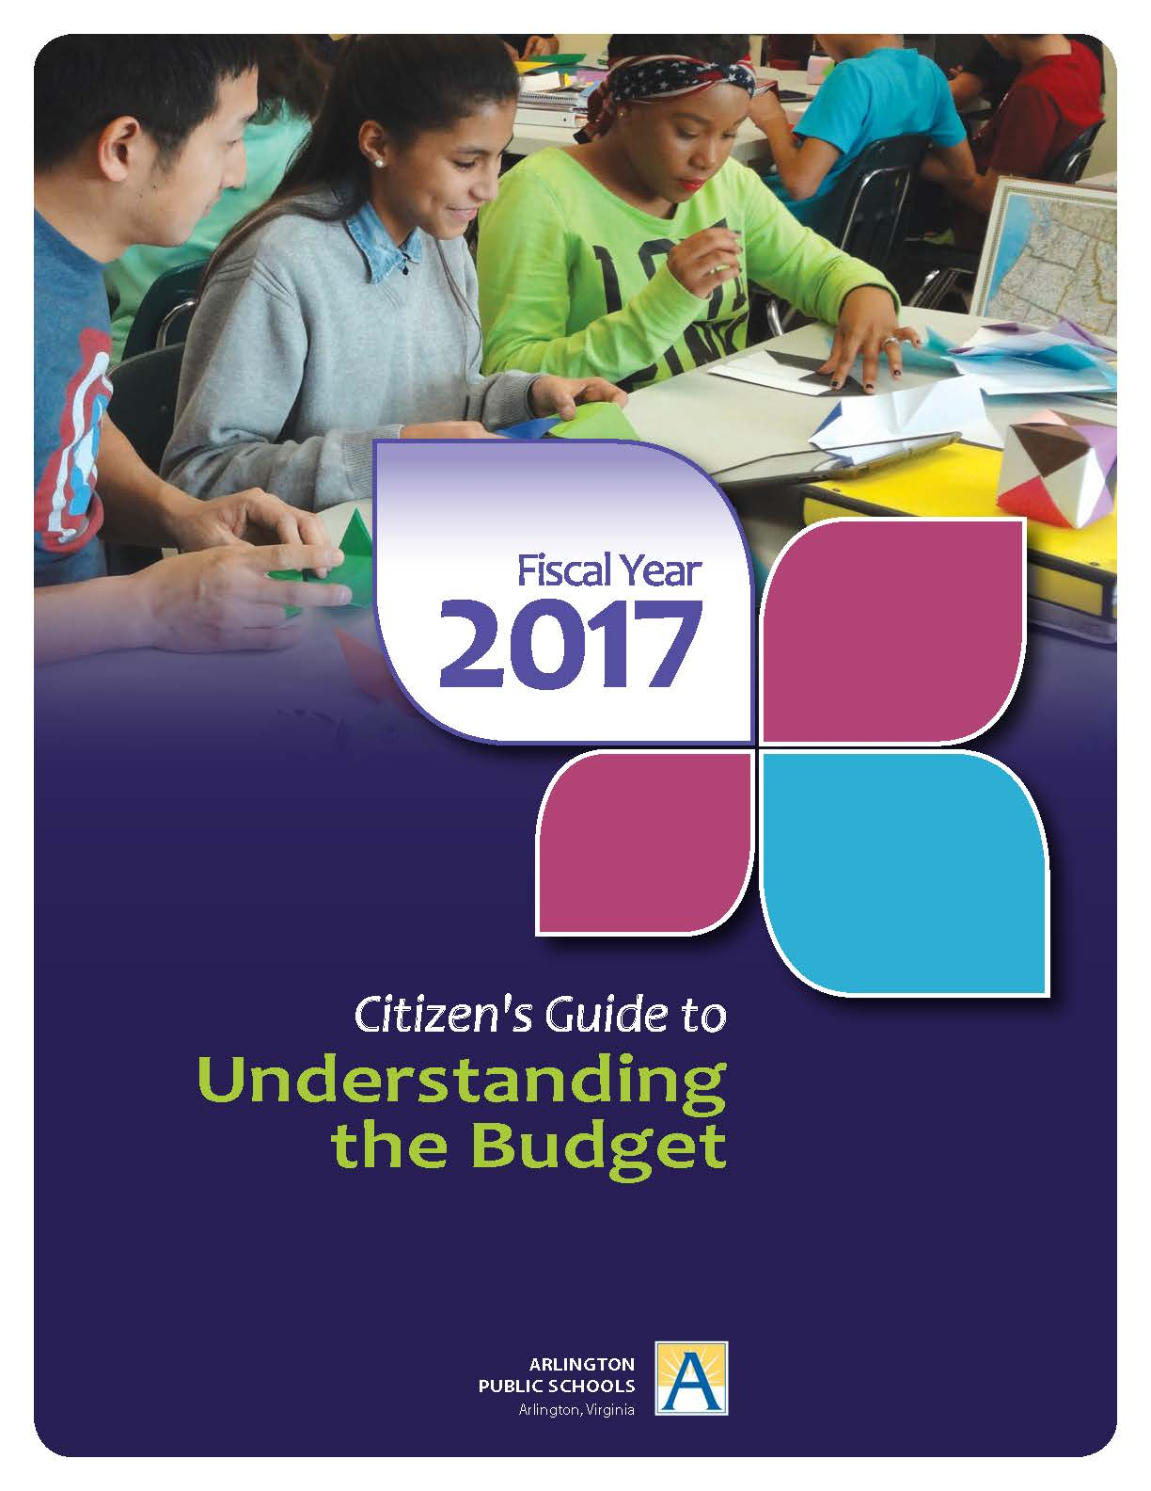

Slide 13
Citizen’s Guide to the Budget
Explains budget in simple terms
Lots of charts and graphs
Includes:
School Board’s mission, visions, core values, and Strategic Plan goals
Overview of budget development process
Revenue and expenditures information
School system demographics
Statistics on spending and efficiency
Facilities capacity and projects
Challenges in coming and out years
FAQs
13

Slide 14
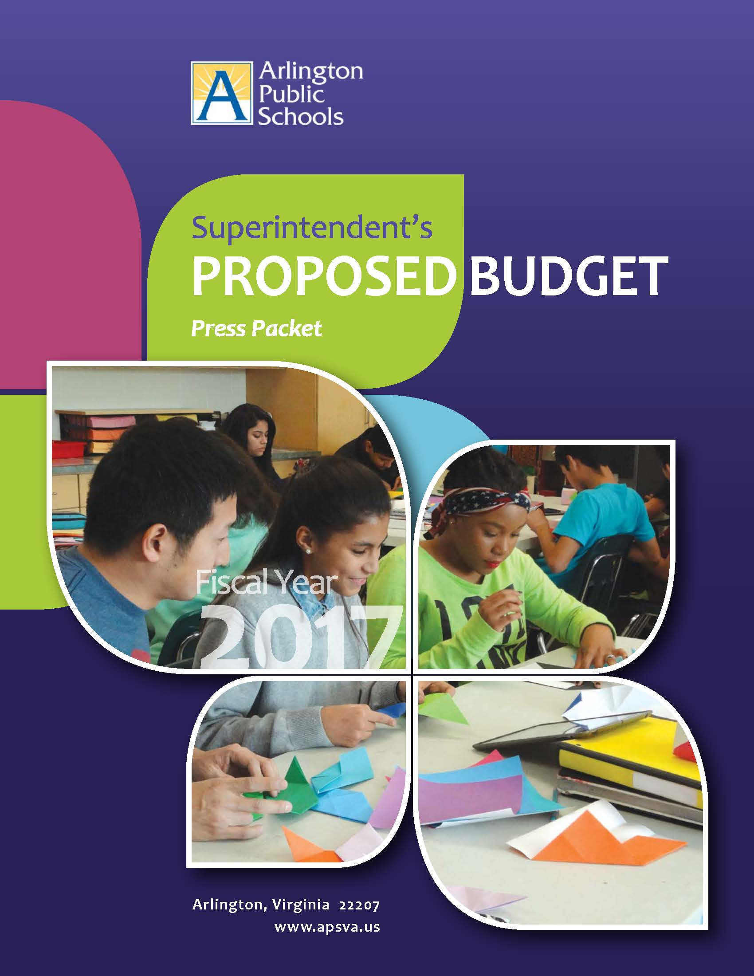
Executive Summary/Press Packet

Slide 15
Executive Summary/Press Packet
Forced by Circumstances
Introductory Section of Budget
Executive Summary
Surprising Result
Community loved it
Not so intimidating
15

Slide 16
“At a Glance” Trifold Brochure

Slide 17
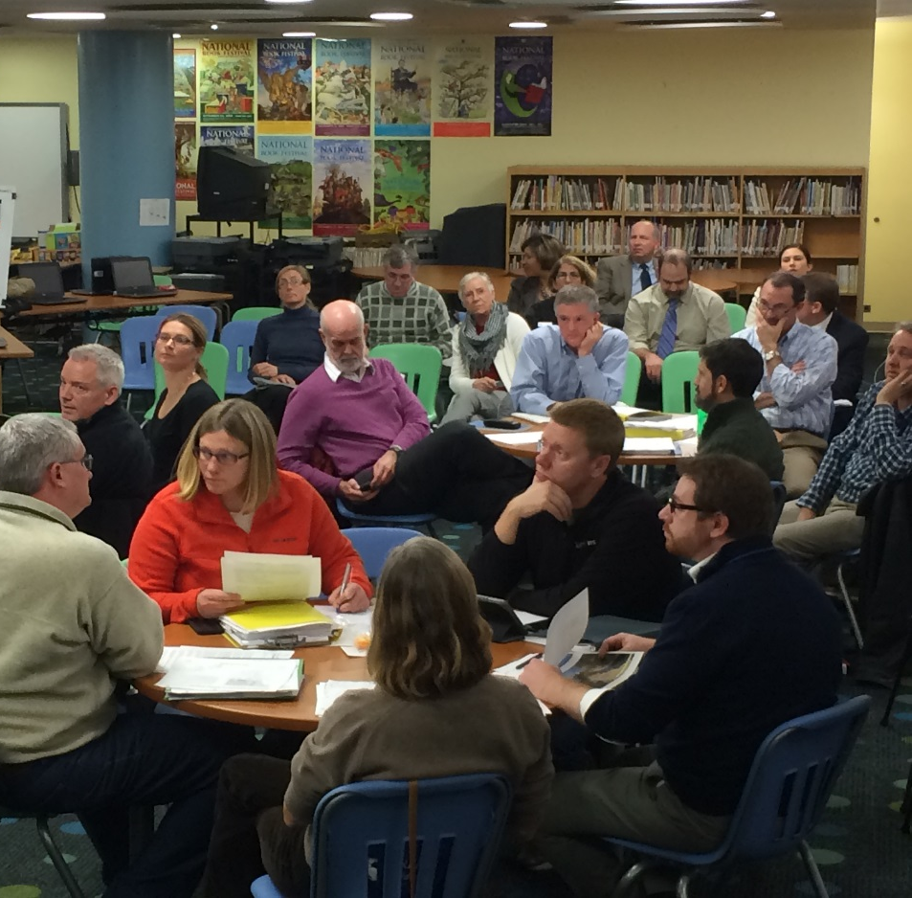
“At a Glance” Trifold Brochure
Supplemental Tool
Small and Portable
Mostly Charts and Graphs
Easy to Understand
17

Slide 18
Summary
School Board Provided Foundation
Budget Standards and Guiding Principles
Priorities and Budget Direction
Multi-pronged Approach to Community Engagement
Can be changed from year to year
Created More Opportunities for Feedback
Wide Distribution of Materials
Posted on web site
Emailed to all subscribers of school network
Printed and distributed
To all schools
At every community meeting
18

Slide 19
Summary
Resulted in:
Greater community participation
Deeper community understanding of inherent trade-offs
Insight into:
What community felt was important
What they were willing to give up
Increased support of budget
Community advocated for budget at County level
County support of budget grew over 4% each year
19

Slide 20
Community Engagement in the Budget Process
VASS-VASBO Workshop
December 15, 2016
Leslie Peterson, Assistant Superintendent, Arlington Public Schools

